Slide 1

CLAIM MANAGEMENT SYSTEM
Team Members
Saradindu Rana :2232733
Spoorti Lnu:2232508

Slide 2
Table of contents
●Problem statement
●Approach
Plan of the project
●Requirements
●System Architecture
●Microservices and Modules
●Screenshots

Slide 3

Problem Statement
The project is aimed at helping the insurance company, insurer and surveyor to register, settle the claim and generate the report to observe and check the management of insurance company.

Slide 4
Approach toward the project
1. SRS document was gone through.
2. Developing microservices and UI
3.Unit testing.
4.Integration of the services and UI

Slide 5
Plan of the project
3 days
3 days
2 days
2 days
2 days
Integration of frontend and backend
Project Completion
Developing Microservices
Developing Angular UI
Unit Testing

Slide 6
Requirements
Hardware requirements
Pc / Laptop - 8 GB RAM preferably
Software requirements
Eclipse - Latest version, Spring tool Suite
Node JS
MySQL
Postman
Visual studio code

Slide 7
Frameworks and tools
Spring Boot
Maven
Hibernate
Junit and Mockito
Swagger
JWT
Lombok
Slf4j Logger

Slide 8
Microservices
The Insurance Company
Surveyor

Slide 9
System Architecture
The Insurance Company
Database
Frontend
Surveyor
Database

Slide 10
The Insurance Company
Functions :
update the claim by allocating a surveyor or closing a claim
Pay Fees to the surveyor, and pay Funds to the Insured

Slide 11
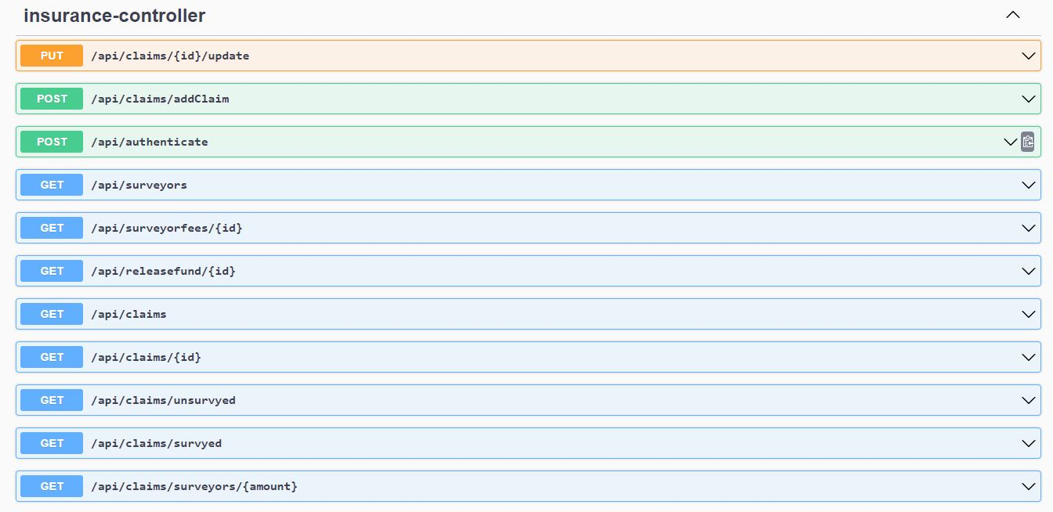
The Insurance Company
Endpoints

Slide 12
Surveyor
Create a survey report which includes all the details like accident details and amount in rupees approved for claim. The amount approved for claim is calculated by using labor charges, policy class, spare part cost, depreciation. Also update the survey report if required.

Slide 13
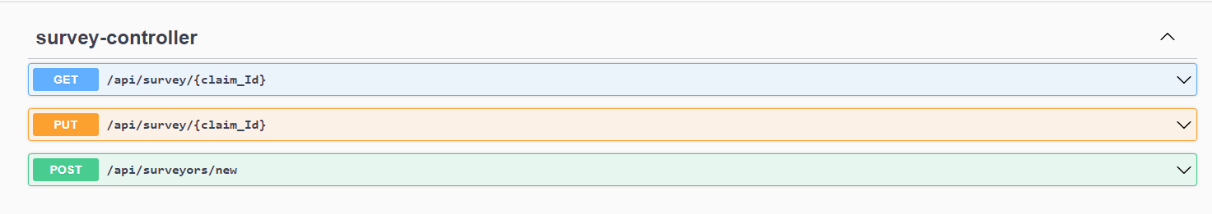
Surveyor

Slide 14
Output

Slide 15
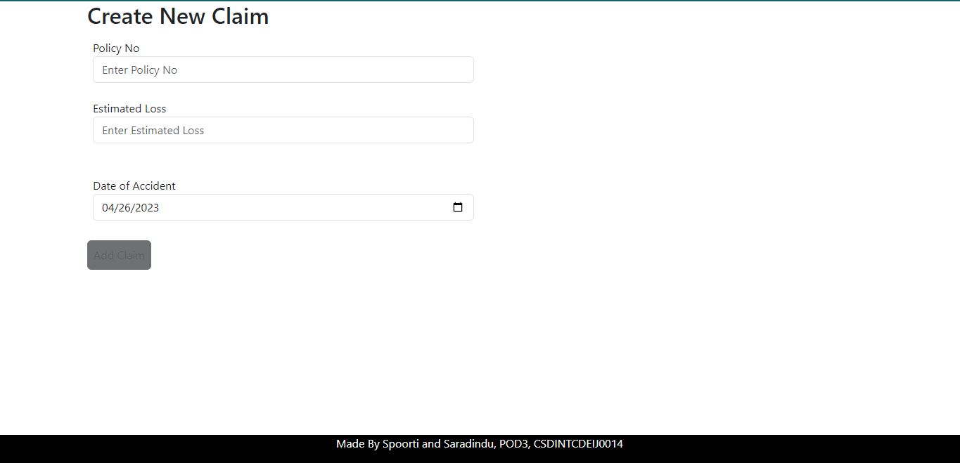

Slide 16
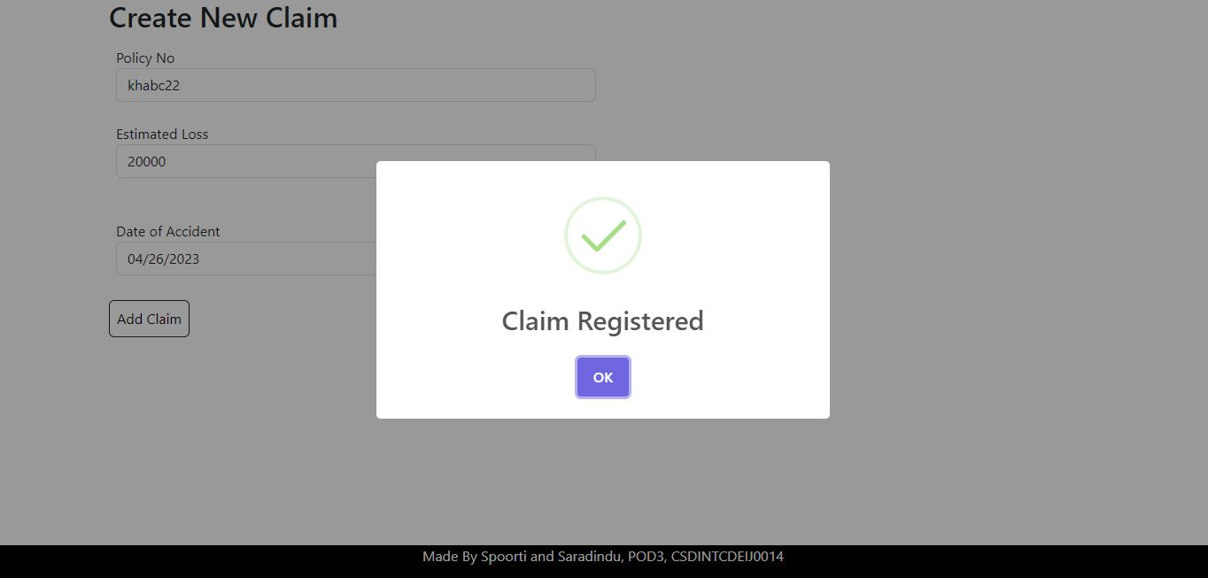

Slide 17
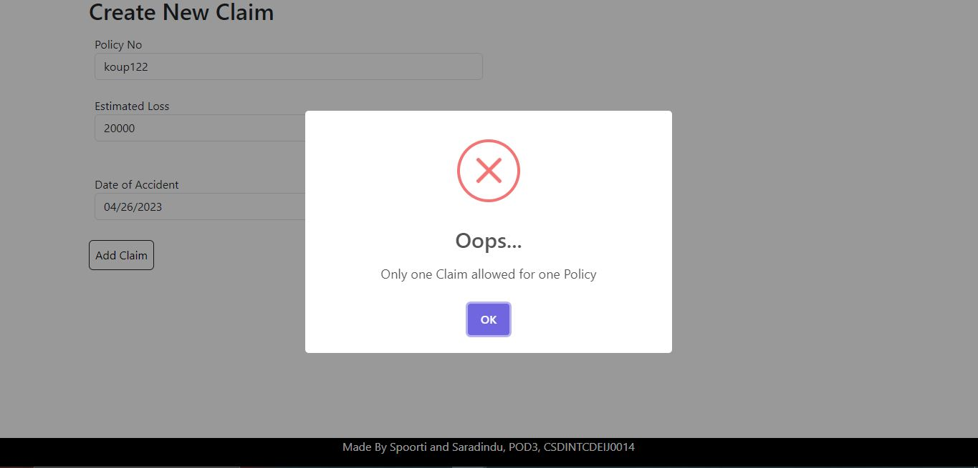

Slide 18
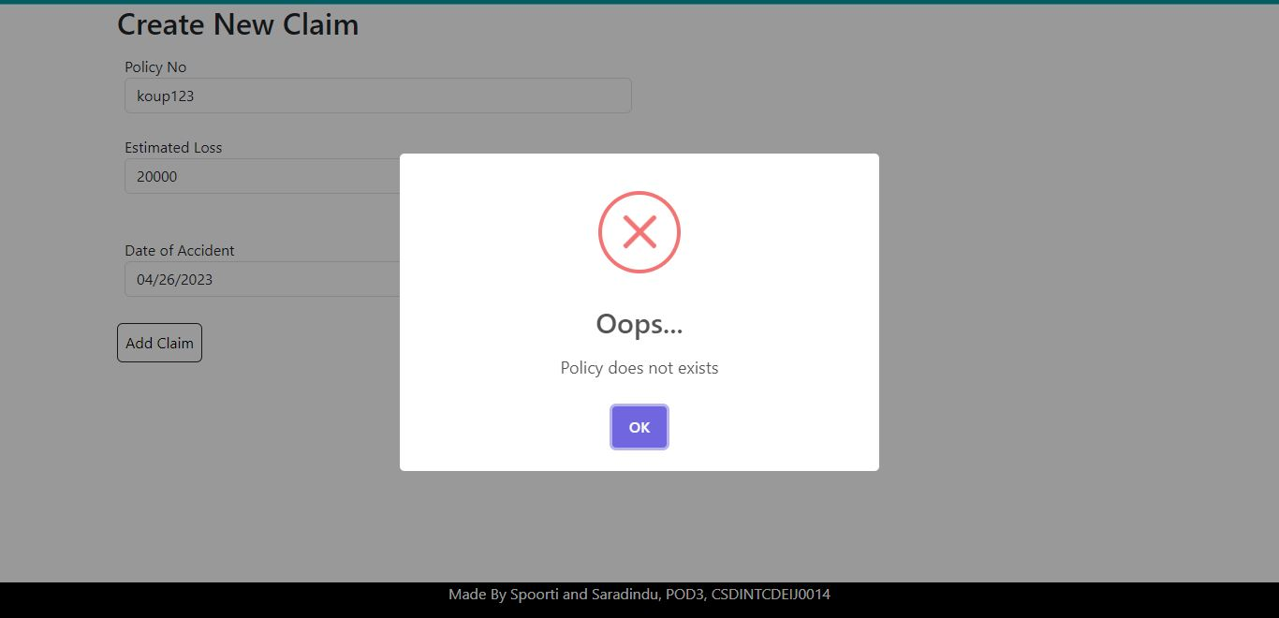

Slide 19
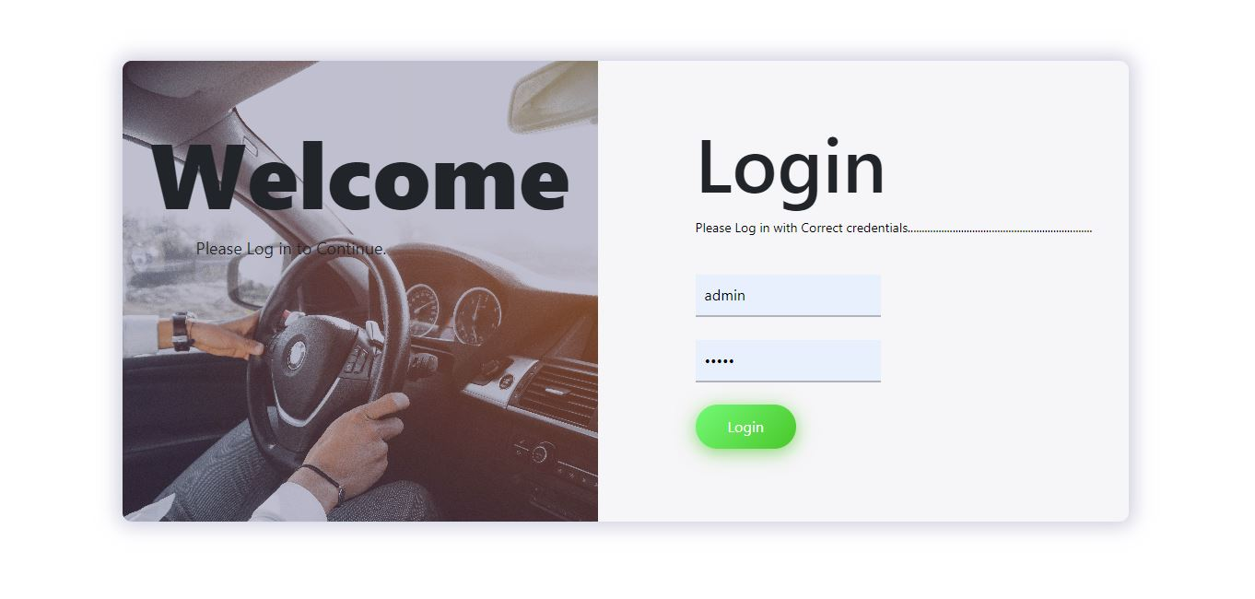

Slide 20
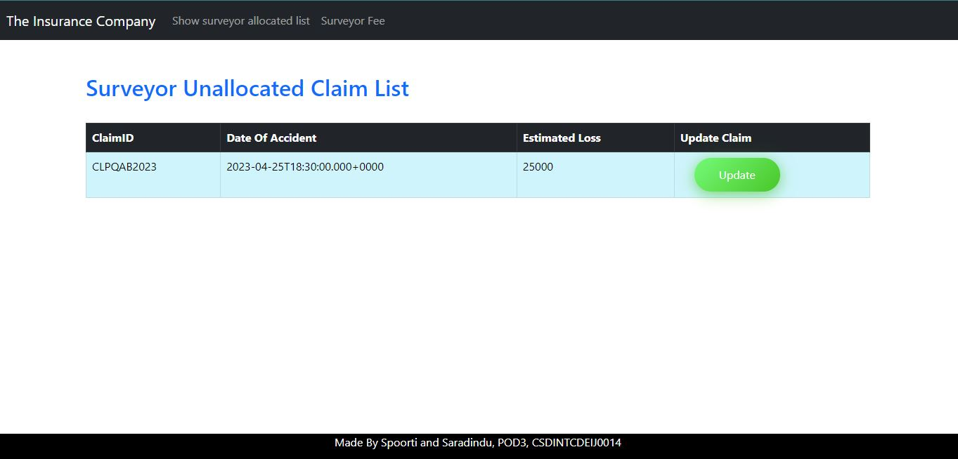

Slide 21
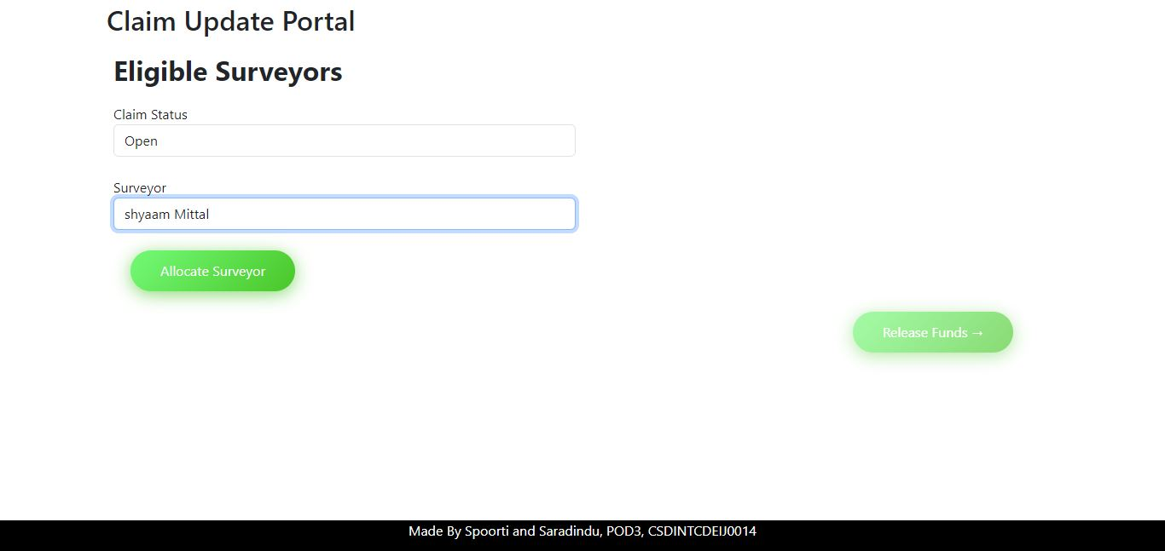

Slide 22
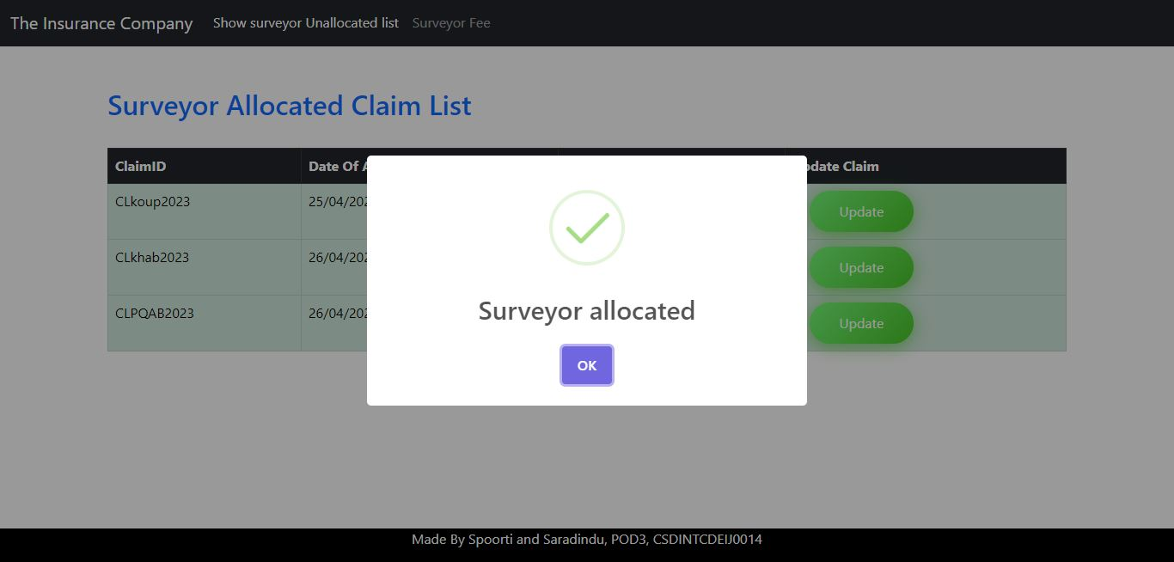

Slide 23
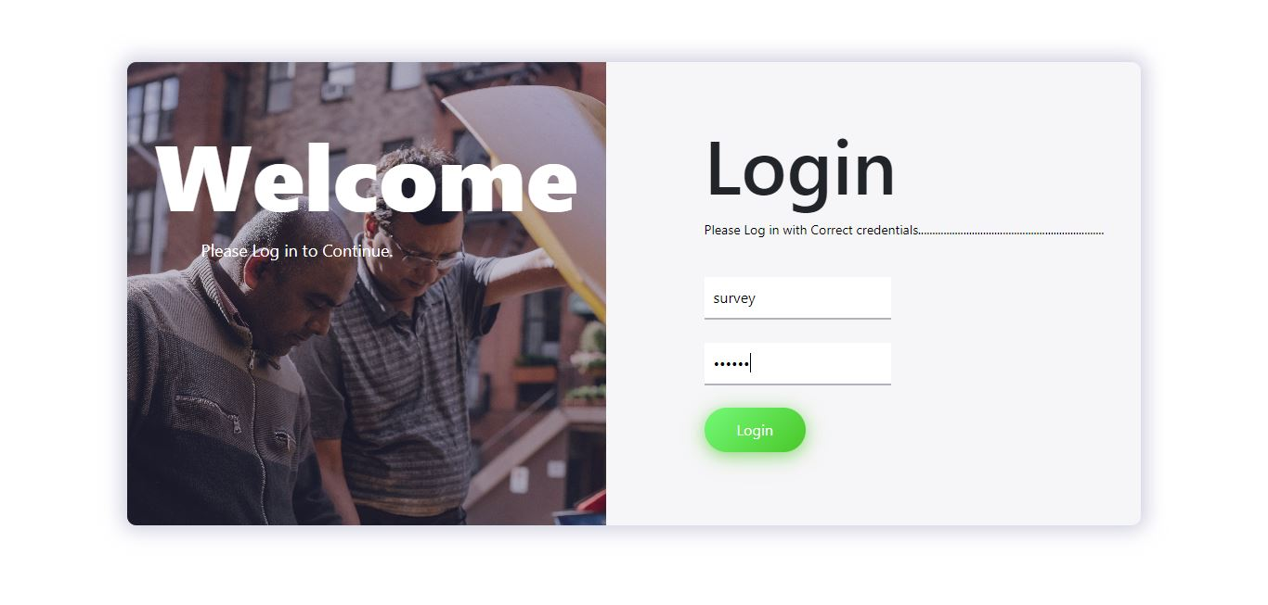

Slide 24
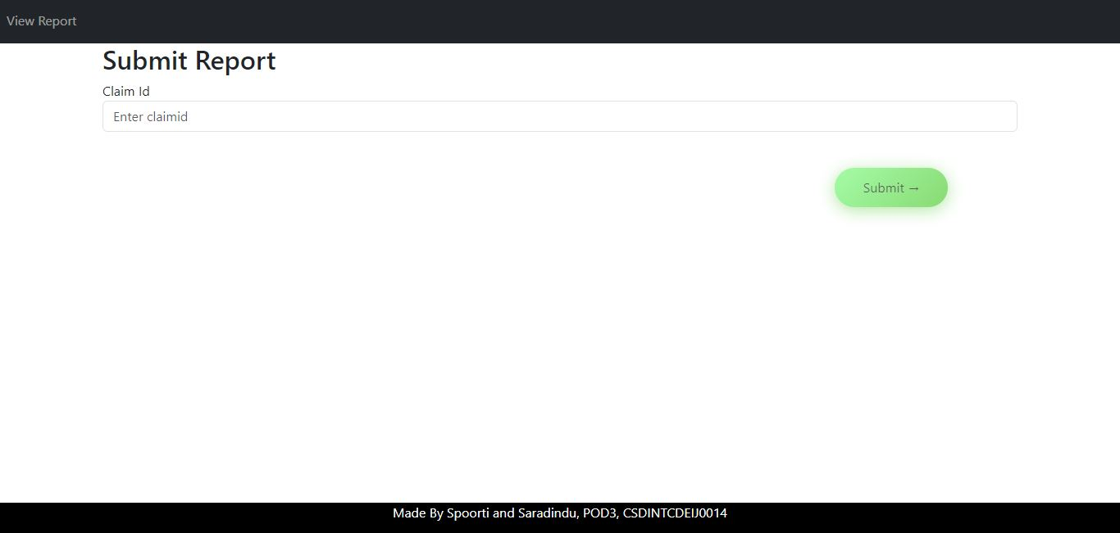

Slide 25
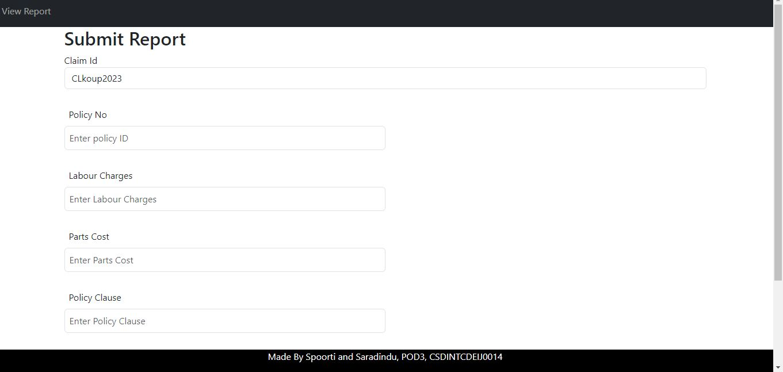

Slide 26
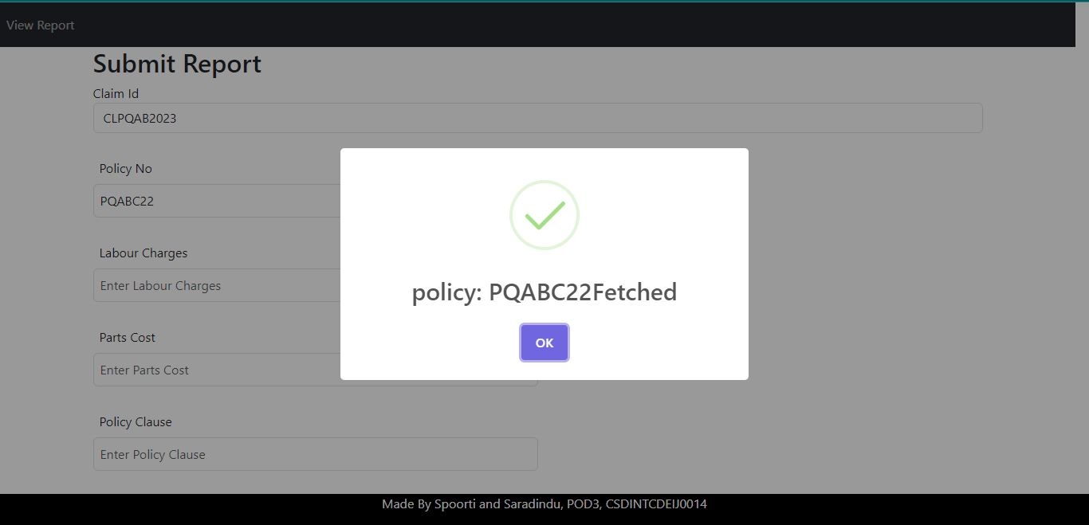

Slide 27
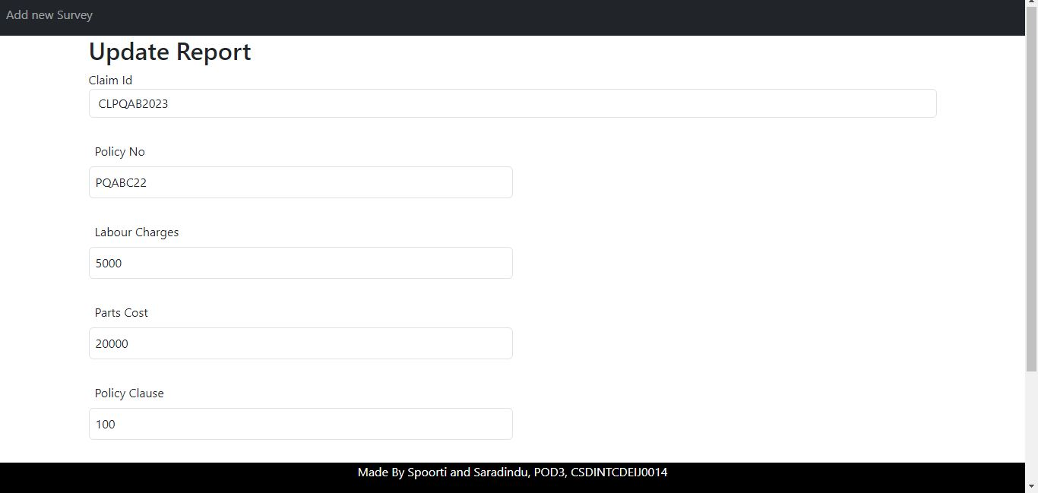

Slide 28
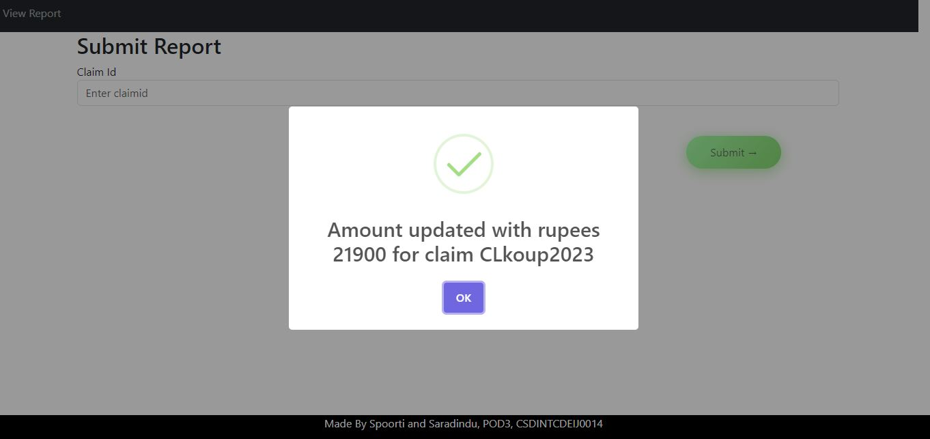

Slide 29


Slide 32
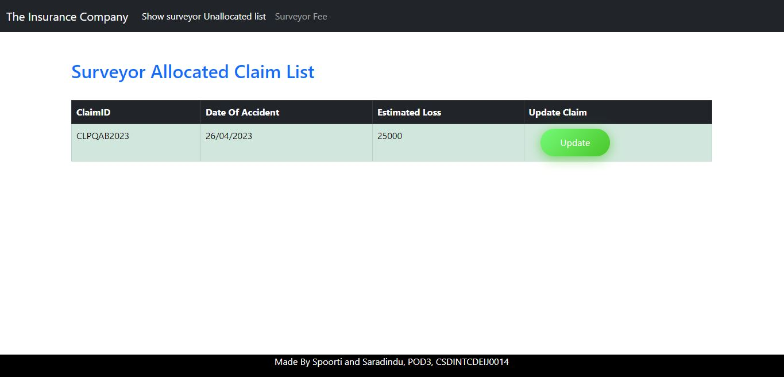

Slide 33
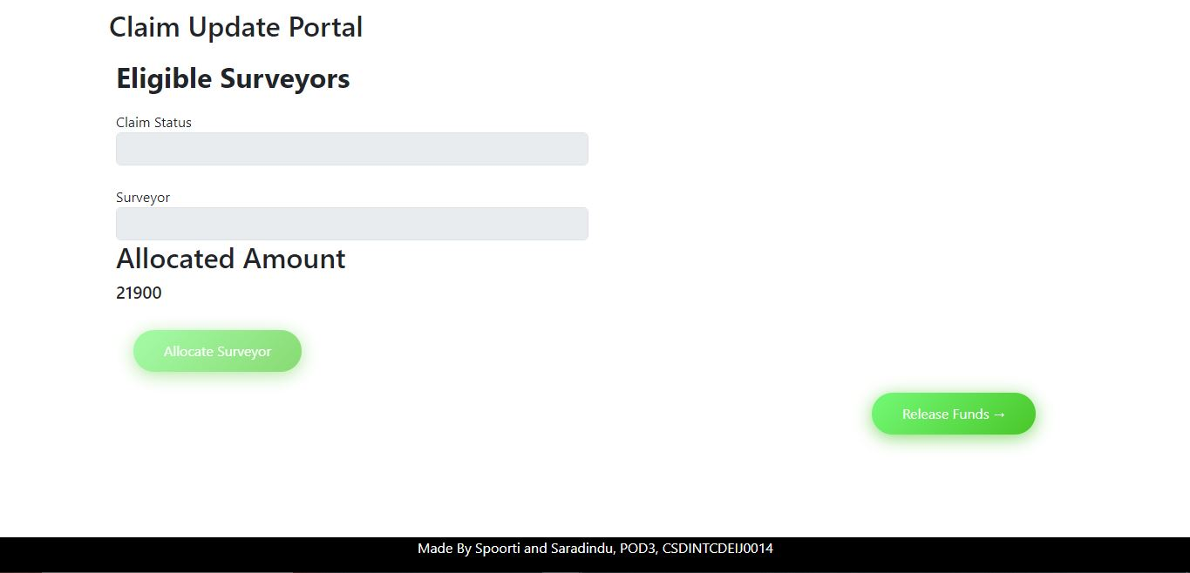

Slide 34
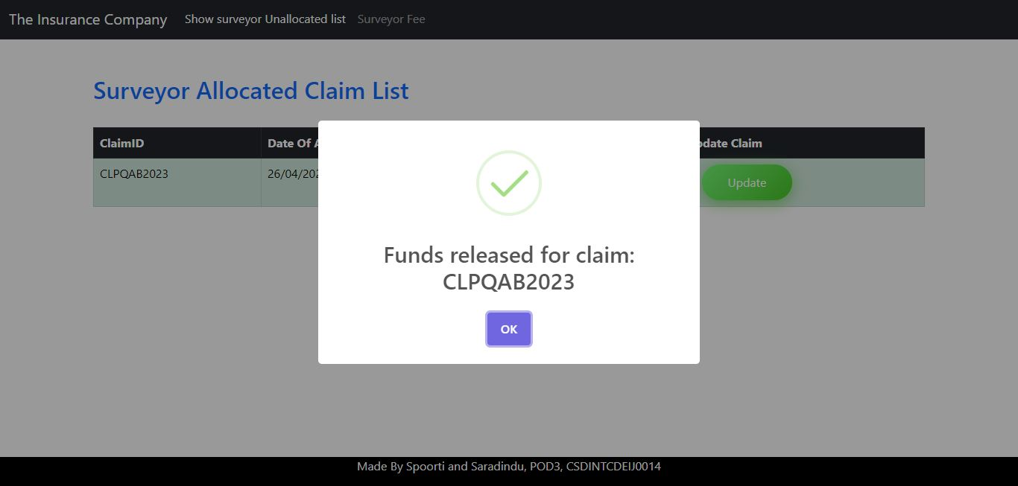

Slide 35
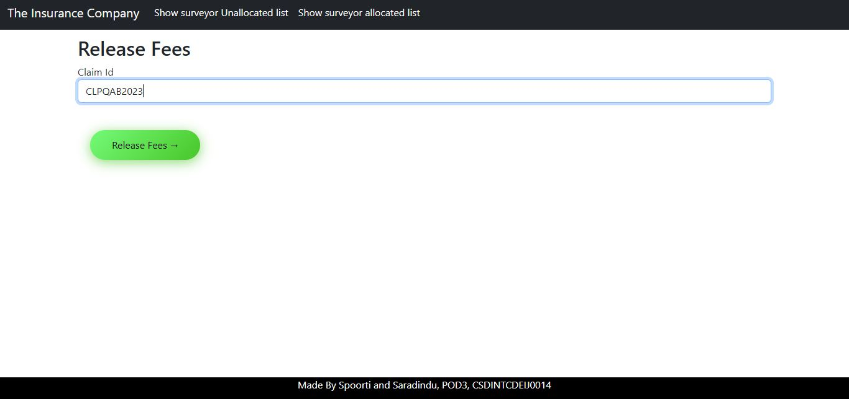

Slide 36
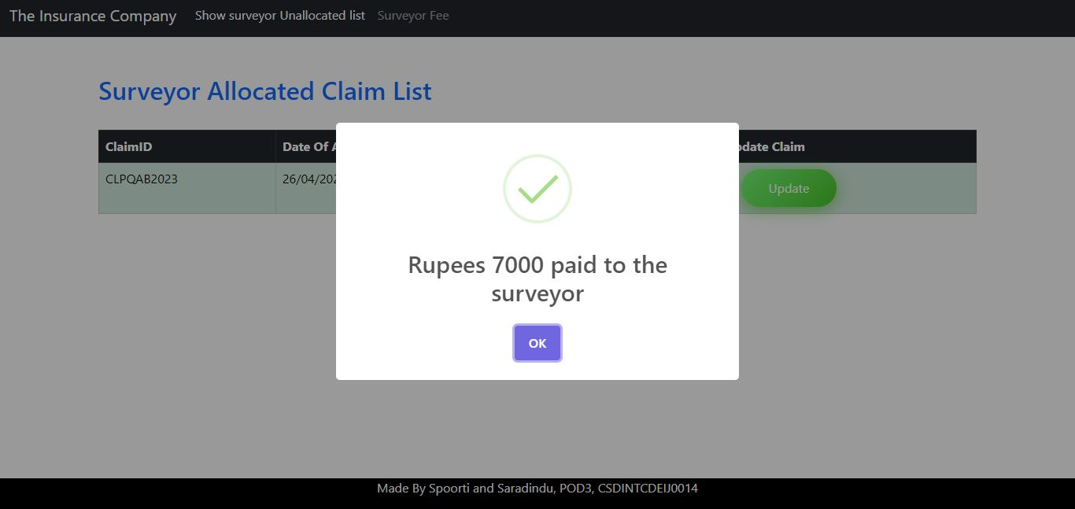

Slide 37
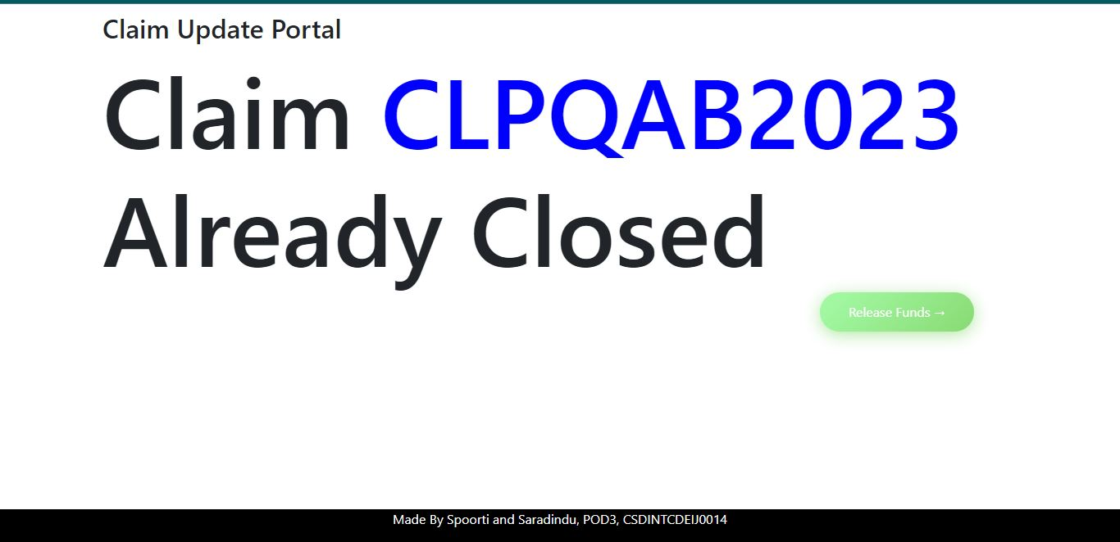

Slide 38
Thank You

